Slide 1
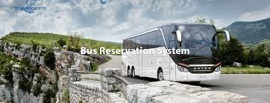
BUILDING BUS RESERVATION SYSTEM

Slide 2
NAME:DHANUSHYA COLLEGE . CODE:6202 REG NO:620221104004

Slide 3
ABSTRACT
Online Bus Ticket Reservation System is a web-based application that works within a file. One network. This project introduces an update to the software program “Online Bus Ticket Reservation System ”as it should be used in the bus system, the area used reserved seats, booking cancellations and various types of route inquiries used for security quick booking. OBTRS is designed to manage and compile a traditional database, ticket booking and bus tracking and departure made. Maintains all customer details, bus details, booking details

Slide 4
PROBLEM STATEMENT
Currently, the type of system used in the counter is the internal system used manually to sell bus tickets. The company’s problems are that customers have to go to the counter to buy a bus ticket or ask for a bus system, customers will also have to wait in line for longer to get a bus ticket and will also have to pay cash when

Slide 5
PROJECT OVERVIEW
This system would help customers to book a seat for their journey, book a bus. This system would also help the owner to manage the coaches, employees, clients, services, etc Bus Reservation System will increase the booking process faster, convenient, and comfortable. Customers can book their desired seats. They can check the availability of posts on a specific date. The customer can check availability, book a ticket, or cancel a ticket 24X7. The online system is available to use anytime. The user doesn’t require to visit any office.

Slide 6
TECHNOLOGY USES
Web Development Technologies: For a web-based booking system, technologies such as HTML, CSS, JavaScript, and a server-side scripting language like PHP, Python or Ruby can be used to build the front-end and back-end of the system. Databases: A database technology such as MySQL, MongoDB, or PostgreSQL can be used to store booking information and customer data.
Framework: A framework such as Ruby on Rails, Laravel, or Django can be used to structure the development process and provide a set of common tools and libraries. Payment gateways: Payment gateways such as Stripe, PayPal, or Braintree can be integrated into the booking system to securely process customer payments

Slide 7
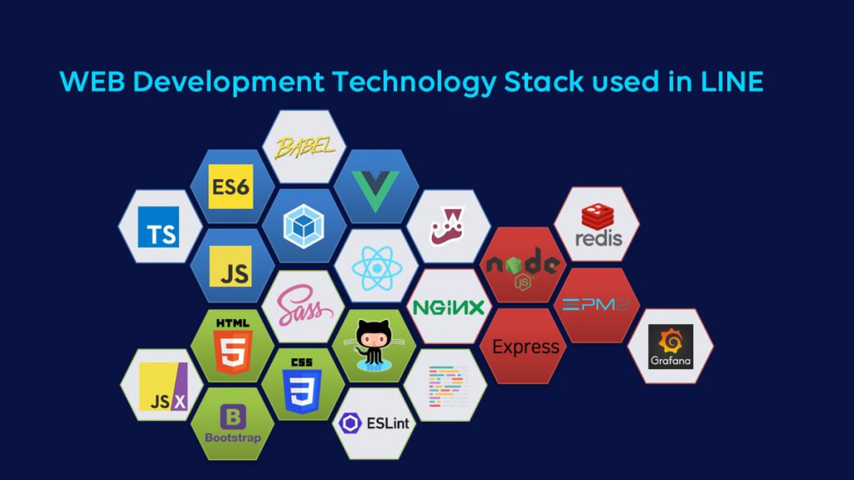
FRONT END

Slide 8

BACK END

Slide 9
MODELING
The data flow diagram (DFD) is represented by a graphic “flow” of data through the information system, modeling its process processes. DFD indicates what type of information will be entered and exited from the system, where the data will go in and out, and where the data will be stored. Deal development of DFD’S is done at several levels. Each process in low-level drawings may be reduced to a detailed DFD to the next level.
Highquality painting is often referred to as contextual drawing. It contains a single process, which plays a key role in studying the current system. The process in graphic content level exploded into another process at the first

Slide 10
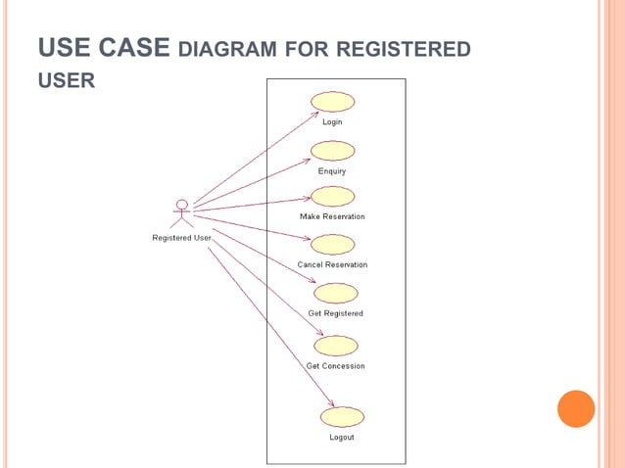

Slide 11
RESULT
The program will be developed using a waterfall research method as well design objectives, PHP as a programming language due to its server side processing capabilities to make the data process subordinate to the client itself computer, implementation strategy and testing and care strategies suitable for good posting of the program. Research and development are continuous processes; It is similar in computer and software development. However, this work is recommended for Emo Transport Co. Ltd., Owerri, as they are still operated manually and may also be useful for other bus transport industries whose processes are still performed manually. She goes. The system can contribute more on the bus representatives who handle the account if it can produce a report by travel so that they will not go to a certain module to check the reservation and its details. Also, it would be more beneficial for both customers and bus representatives if customers can create an account just like on the airlines websites. With this, the system can record the modifications made

Slide 12
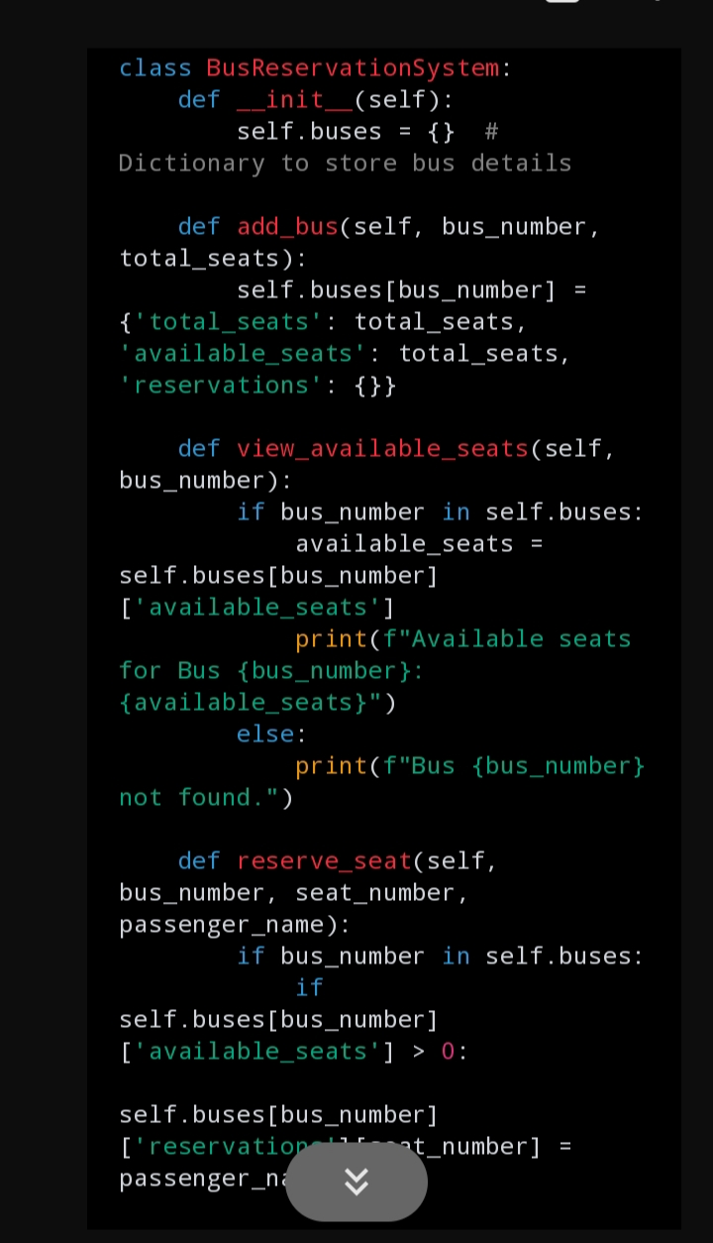
SCREEN SCHOT

Slide 13
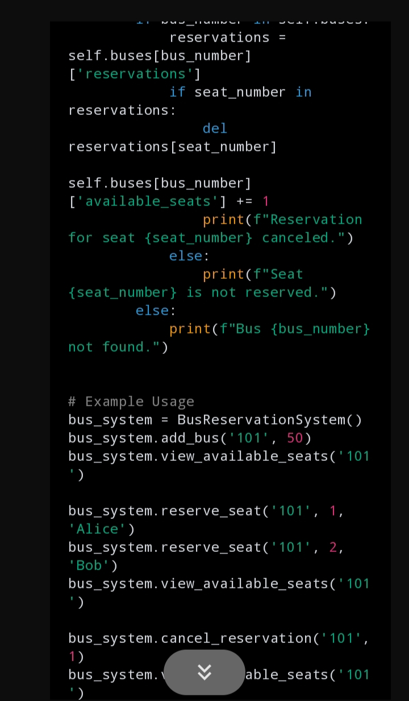

Slide 14
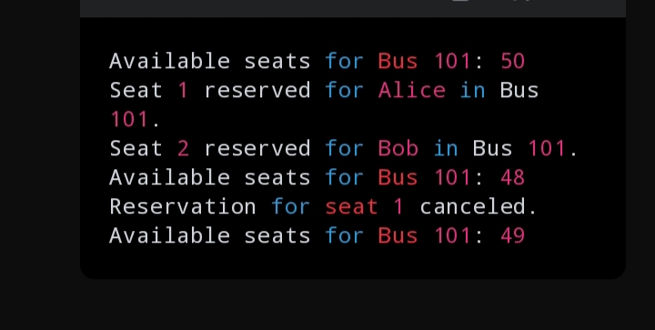

Slide 15
FUTURE ENHANCEMENT
You can access the online system at any time. The user is not required to visit an office. All you need is a web connection and a device to use our system. They can look up the route, price, and class, among other thing They can pay using a credit card, a debit card, internet banking, a PayPal-like online wallet, or cash.

Slide 16
CONCLUSION
It can be seen that computer applications are very important in every field of human endeavor. Here with this new system all the information about the customer making a reservation can be obtained by clicking a button, removing some of the difficulties that come with the manual system. This will reduce the workload of the employees, reduce the time taken to make reservations at the bus terminal and will also increase the efficiency. The application also has the ability to automatically update records in various files thereby relieving the employees of the stress of working with the file security of the data. This project will, overall, give a new path to the bus reservation and ticketing processes.

Slide 17
THANK YOU

